Slide 1

GU02 - Bioinspired Temporal Data
Main teacher: professor Santa Di Cataldo Project owners: teaching assistants
Gianvito Urgese, Vittorio Fra
Contributors:
Alberto Castrignanò 281689
Lorenzo Mercurio 290903
Stefano Rainò 282436
Machine Learning in Application course project, Polytechnic of Turin

Slide 2
Our goal!
1°task
KMEANS Clustering
Pareto Front evaluation to choose the best number of clusters K
Study new methods for Human Activity Recognition problems according to time-dependent signals, in order to reduce the computational effort, necessary to study them, through new technological solutions like sLMU, that perform an approximation for continuous time delay
2°task
LSTM and Dimensionality Reduction
Verify the superclass separation
3°task
LMU Classification
Construction of the LMU cells in order to classify data related to different clusters
4°task
sLMU Classification with NNI
Approximation of temporal cells and optimization of hyperparameters with NNI

Slide 3
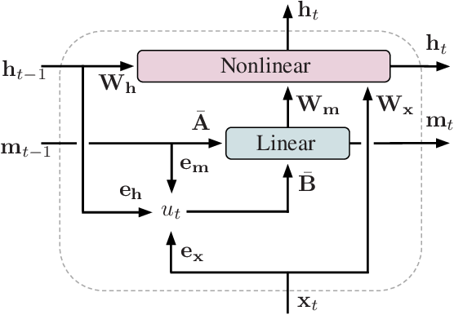
Background: Legendre Memory Unit (LMU)
Legendre Memory Unit (LMU) is a memory cell for RNNs which dynamically maintains information across long windows of time.
The LMU takes an input vector, and generates a hidden state.
The state mutually interacts with the memory, in order to compute nonlinear functions across time, while dynamically writing to memory.

Slide 4
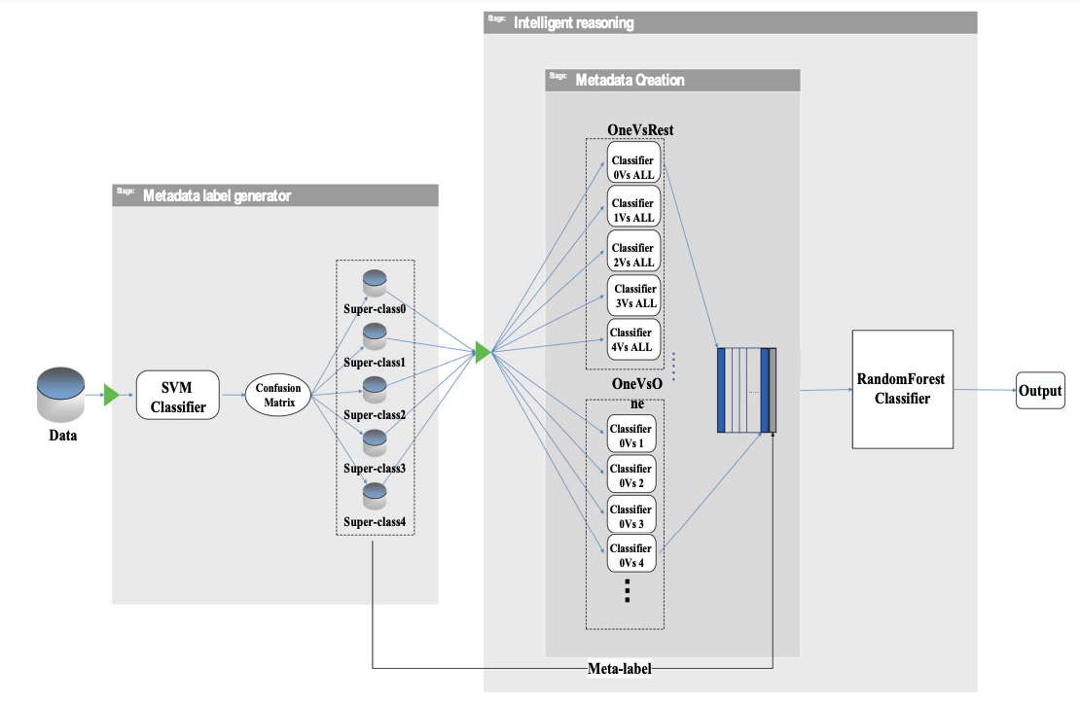
Related works: miRNA biomarkers Classification
Related paper: “Cancer miRNA biomarkers classification using a new representation algorithm and evolutionary deep learning”
The deep learning superclass/met-label approach consists is:
Partitioning data into super-classes: the cancers in the same super-class would have maximum separability and minimum overlap
Meta-data creation: the samples belong to the category of interests are labeled as positive, the others as negative
Super-classes classification: the CNN model is used to predict the actual label of the sample

Slide 5
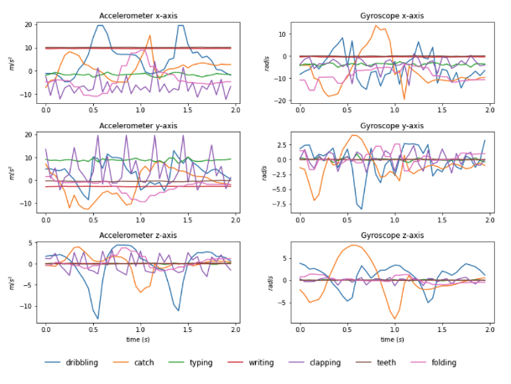
WISDM Dataset
Temporal behaviour on each sensor axis of a random sample for some classes
WISDM is a dataset which contains accelerometer and gyroscope time-series sensor data collected from smartwatch
Each activity was performed for 3 minutes. These activities include:
Basic ambulation-related activities
Hand-based activities of daily living
Eating activities

Slide 6
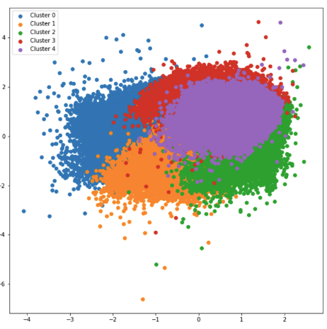
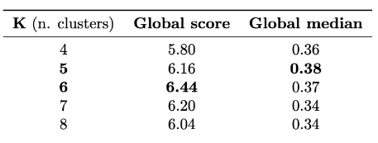
KMEANS Clustering
KMEANS is a method that aims to partition N observations into K clusters in which each observation belongs to the cluster with the nearest mean.
We are able to judge the quality of the clusters through an evaluation of Pareto front type, based on: Global score and Global median. The results are:
Cluster 1: Sitting, Eating chips, Clapping
Cluster 2: Jogging, Eating pasta, Kicking, Playing catch w/tennis ball, Dribbling
Cluster 3: Drinking from cup, Eating sandwich, Writing, Folding clothes
Cluster 4: Walking, Stairs, Standing, Typing, Brushing teeth, Eating Soup

Slide 7
KMEANS Clustering: Why K = 4?
K = 6
There are two clusters, among the six present, for which no class is represented in a majority manner
6
K = 4
All the clusters has at least one class for which it is represented inside it in a majority manner
4
5
K = 5
There is one cluster, among the five present, for which no class is represented in a majority manner

Slide 8
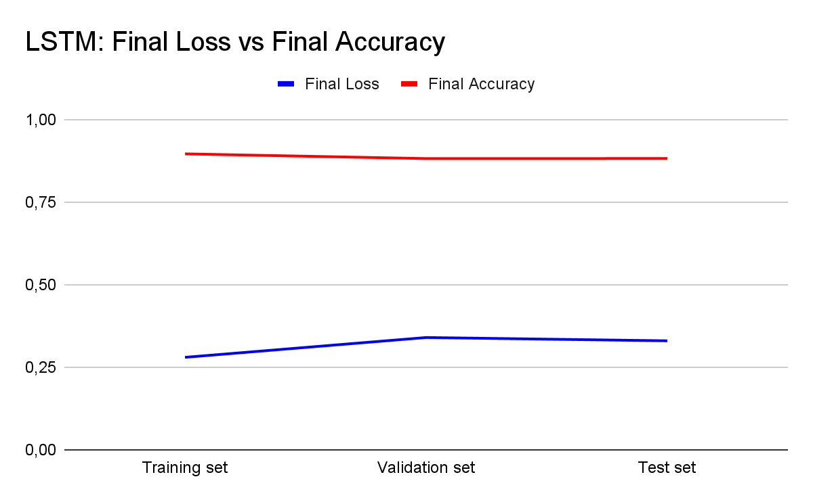
LSTM and Dimensionality Reduction
The application of LSTM was performed in order to verify if it will be able to separate the new data well in the right supercluster, and then insert it correctly in the right final classifier
The labels are built on the basis of the belonging cluster associated with the reference class of the sample

Slide 9
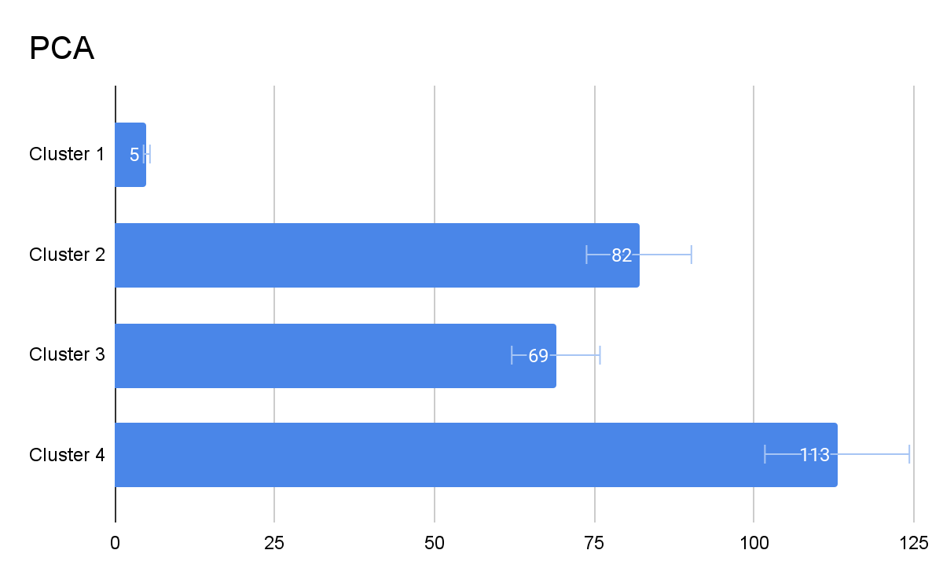
Feature Selection and Cluster Separation
The PCA application has planned to select, for each cluster, the number of components in order to preserve the variance despite the reduction in terms of dimensionality. Two trends:
Individual explained variance
Cumulative explained variance

Slide 10
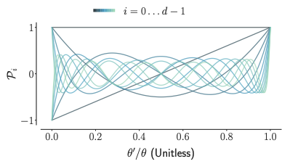
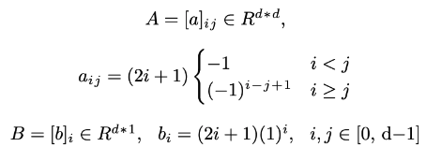
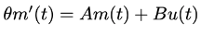
LMU Classification
The Legendre Memory Unit is a memory cell that orthogonalizes the continuous-time history
The cell is derived from the linear transfer function for a continuous-time delay, which is best-approximated by d coupled ordinary differential equations:
The ideal state-space matrices (A, B) are derived through the use of Padè approximants:

Slide 11
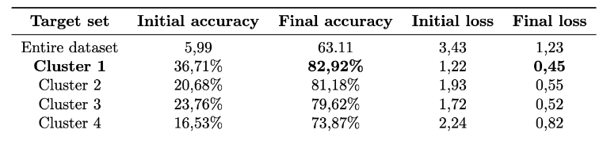
LMU Classification: NengoDL
Ensemble
NengoDL represents a simulator able to provide sophisticated networks featuring cognitive abilities starting from single neuron models
Node
Connection

Slide 12
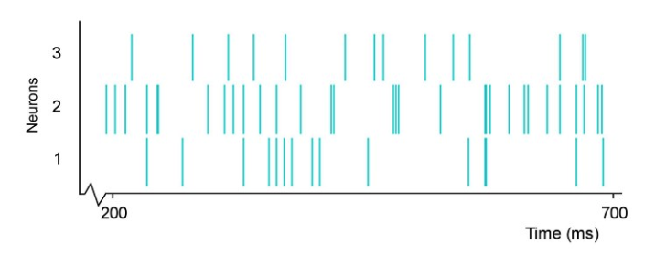
Spiking LMU (sLMU)
Spike trains for a network of 3 neurons
Spiking Neural Networks, thanks to their event-based asynchronous operations, could be considered energy-efficient solutions
The temporal sparse activity is based on spikes which are related to as action potentials.
They also allow to treat time as an additional dimension of input signals
We can transform LMU model by replacing standard activation function with Nengo’s spiking neurons

Slide 13
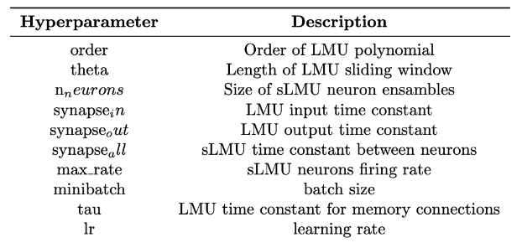

sLMU: NNI Optimization
The experiment output contains the specified performance counters, allowing to elaborate them as needed. The parameters optimized are:
Neural Network Intelligence is an easy to use toolkit, that allows to configure an experiment to be carried out through a Neural Network, and then executing the experiment many times (trials)

Slide 14
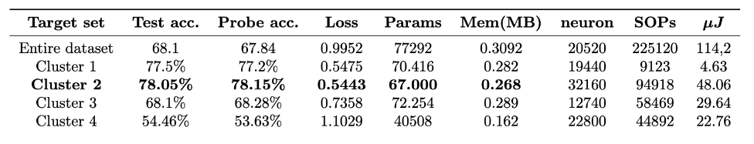
Experimental Results
Thanks to NNI we have tracked prediction and accuracy loss, and its output can be used to simulate the energy consumption and the memory footprint
Both number of network parameters and memory footprint are much lower with respect to traditional known ANN

Slide 15
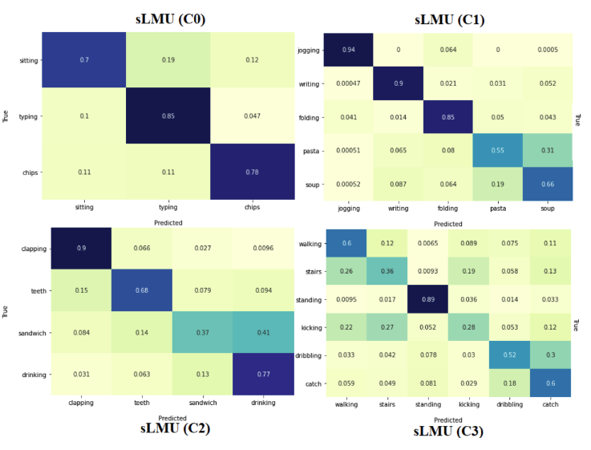
Experimental Results: Confusion matrices

Slide 16
Thanks for your attention
Takeaway
01 | SNNs mantain good performances while offering an important reduction in power and memory consumption, with respect to classic ANN
02 | Having a metalabeling phase would have caused many more wrong predictions

